Slide 1
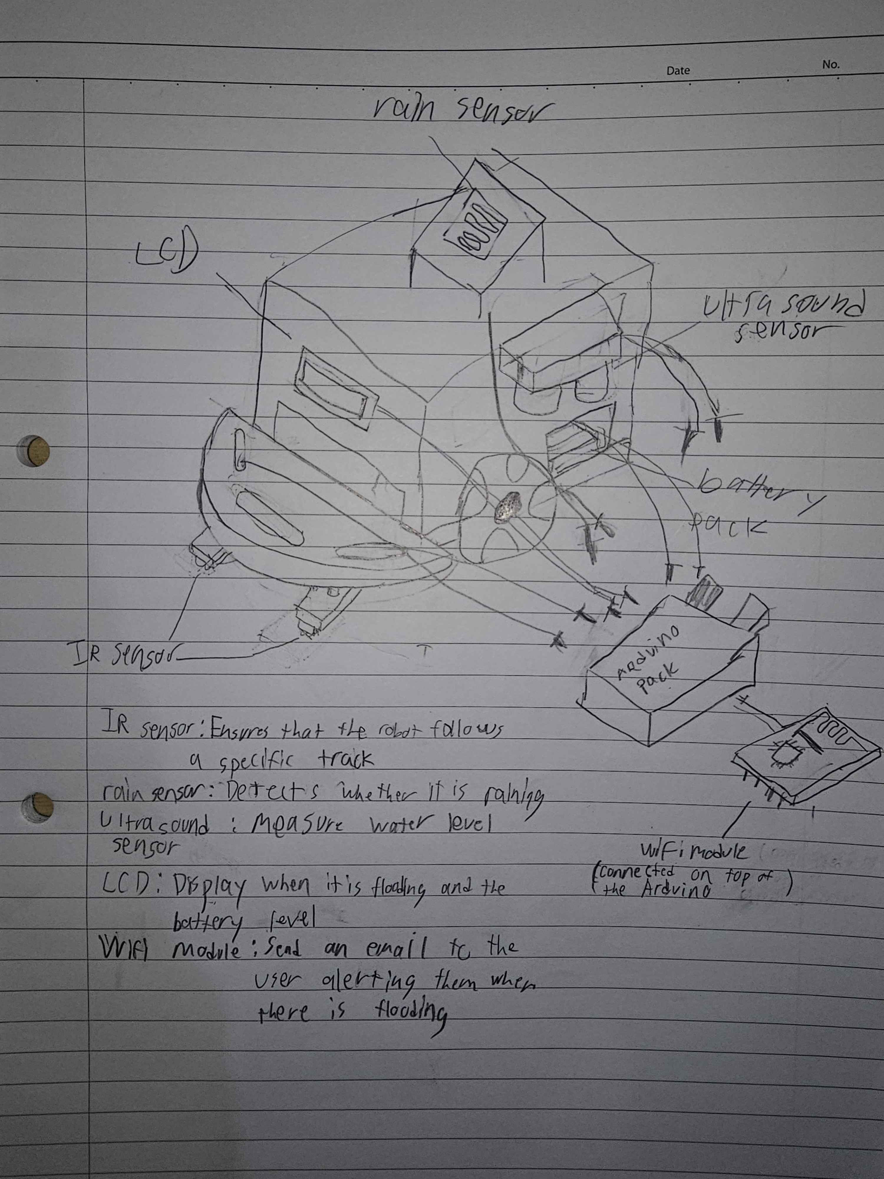
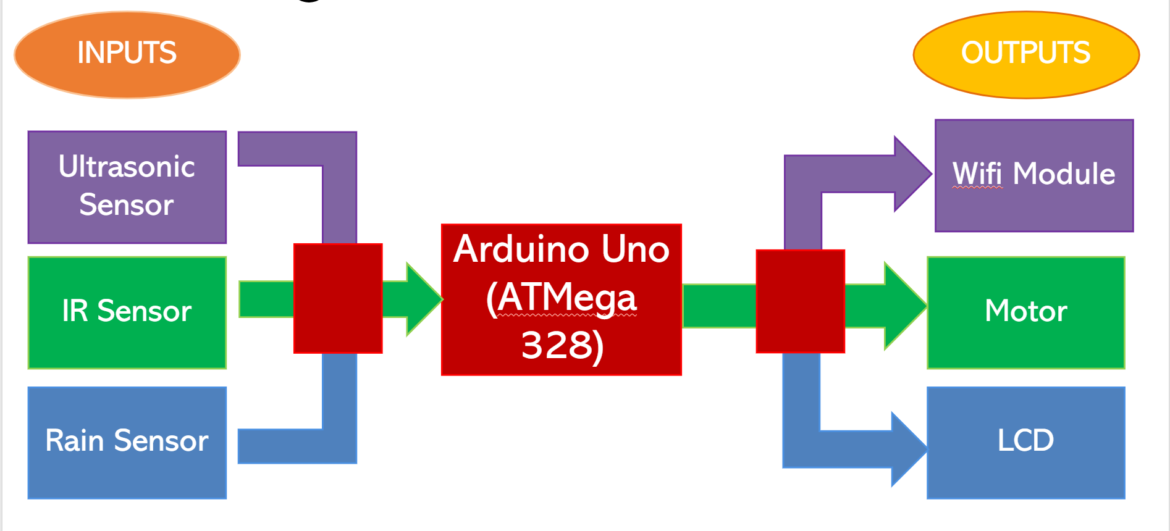
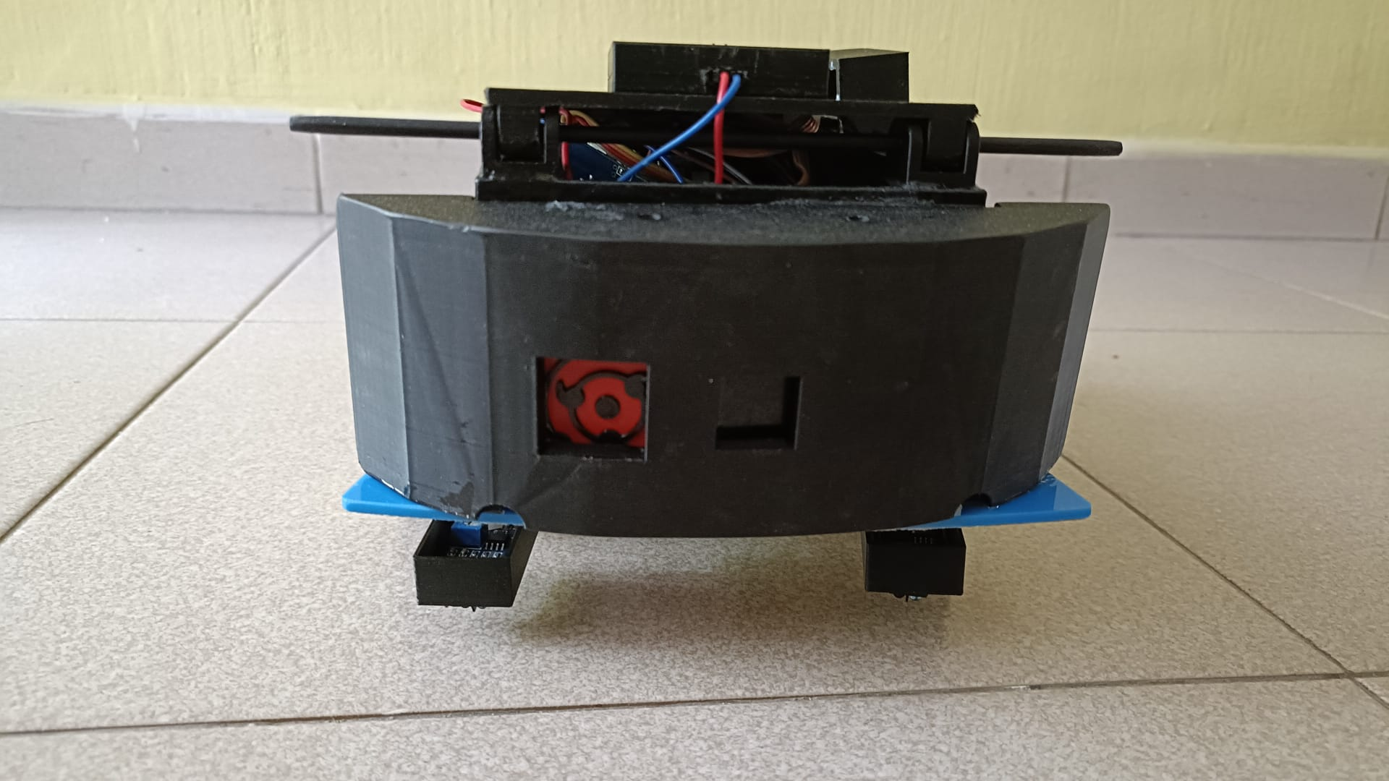
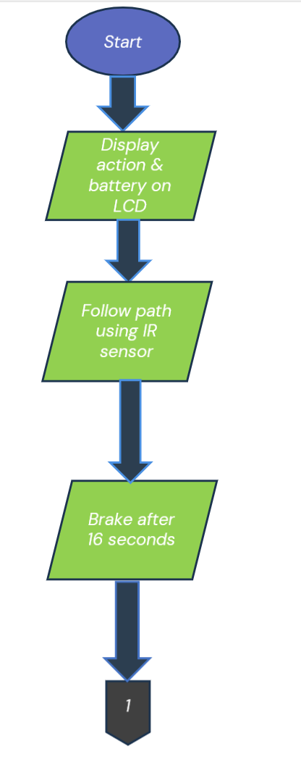
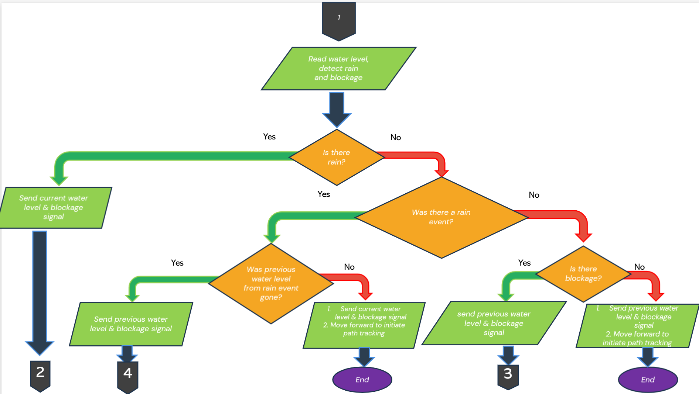
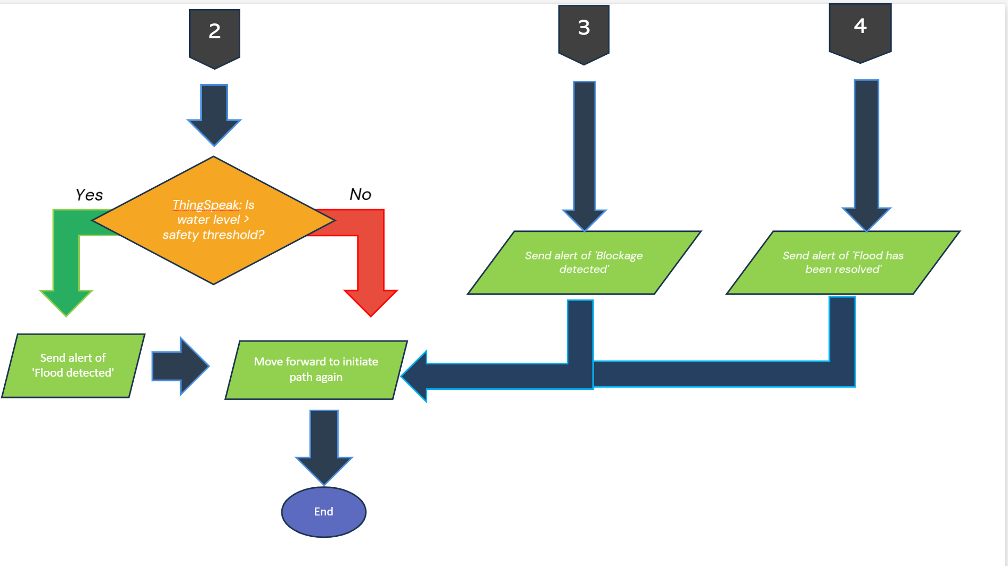
Mobile Monitoring System for Climate-Responsive Environments
ET1015/ET1024 Introduction to Engineering & Design
Problem
Hardware design
Implementation / Outcome / Improvements
Procedure
How can we prevent loss of life from floods?
ctionIn our project we used IR sensor to for track pathing, ultrasound sensor to measure the water level and detect drain blockage, rain sensor to detect whether it is raining, wifi module to send data to thingspeak and LCD to display the car’s current a and current battery percentage.
Our car is able to follow the track almost perfectly and the ultrasound, wifi module, rain sensor and the LCD display all are working perfectly as we envisioned
Future improvement 1: we would like to properly implement our gear idea that allow the height of the ultrasonic sensor to the ground to be adjusted, to account for more complicated terrains such as slopes.
Future improvement 2: we would like the flood detector to be able to send signals to close door vents of citizen’s housing whenever the flood detector detects blockage/flood.
Idea / Objectives
To create a mobile flood detector that can measure the water level and check for drain blockage, then send the data to the user and alert them when there is flooding or a drain blockage.
Project Overview
Software Design
Our Team
Raymond: coded WifiModule, coded ThingSpeak alerts, integrated & debugged the codes. Recorded the video, edited the video​. IR Sensor box, integrated hardware together., worked on powerpoint slides.
Jovier: coded LCD display​, Ultrasonic Sensor box, IR sensor roof laser cut, main box, integrated some hardware together, worked on powerpoint slides​
Kannan: ​coded ultrasonic sensor & rain sensor, made Lid for main box (with LCD hole). Troubleshooted hardware parts by using various tools to fit the project, worked on powerpoint slides
Aisar: path tracking function , slidable and clickable fitting box for rain sensor. Troubleshooted hardware using various tools to fit the project and worked on powerpoint slides​​​​​​​​​
Class: DCPE/1A/24
Lecturer: Jiang Fan
Student members:
P2411514 Jovier
P2519777 Raymond
P2409883 Kannan
P2410597 Aisar

